Slide 1


Northwind Traders Sales Analysis
A complete overview of sale’s ins and outs
-by Saniya Sayyad

Slide 2
About Project
This report aims to provide a comprehensive view of the company’s operations by consolidating data from multiple tables. It will analyze sales performance, customer segmentation, inventory trends, and employee productivity to uncover key insights into customer behavior, sales patterns, and workforce efficiency. Through interactive visualizations and dynamic filters, the report will enable stakeholders to explore data easily and make informed, data-driven decisions.

Slide 3
About
Northwind Traders
Quality isn’t just a word, it’s who we are
“Northwind Traders is a global wholesaler supply chain with specialty in foods and beverages. With an international customer base and diverse suppliers.
We have upto 8 different food categories and 77 different products ,16 different suppliers , 100 unique customers worldwide and 9 multitasking representative handling all over turnover ,with day on day growth in its family, infrastructure ,production“

Slide 4
We have 8 CSV files
Customers-This table stores information about the company's customers and their basic information.
Orders-This table stores information about the Customer’s orders. It includes order ID, customer ID, employee ID, order date, shipped date,shipping address etc
Orderdetails-This table stores detailed information about the items within each order.
Suppliers-This table stores information about the suppliers ,their names ,ids, adress
Categories-This table stores information about the product categories. fields for category ID, category name
Shippers-This table stores information about different shipping companies
Products-This table stores information about the company's products and their details
Employees-This table stores information about the company's employees and their details

Slide 5
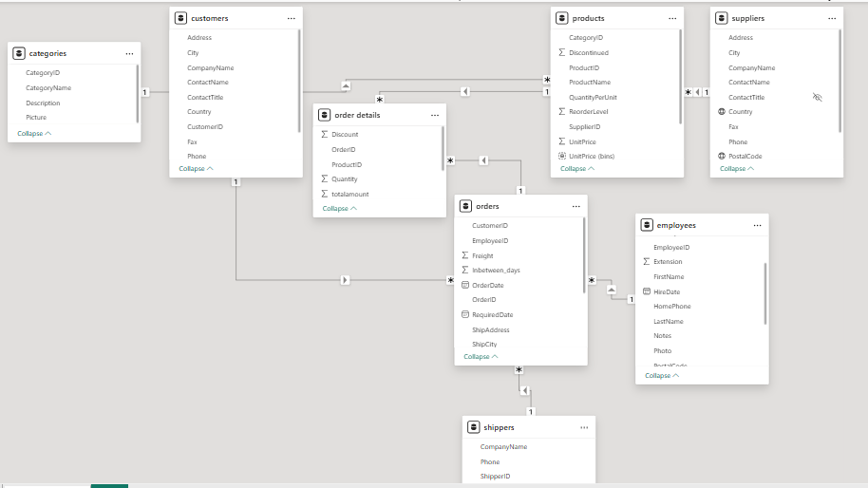
ER diagram

Slide 6
Step by step procedure for sales_analysis
Step1-Data cleaning
Removed duplicates
Replaced nulls with mean/mode/median values
Removed irrelated columns
Step2-Data analysis in MYSQL
Imported all 8 data csv folders then perform further cleaning if needed
Performed EDA in MYSQL

Slide 7
Step3-EDA in excel
Imported same 8 files power query
added them to data model and performed data modelling ,joined those table together on used one to many relationships.
Created data dictionary for files
find out same answer in pivot table ,then performed charting of final output.
Step4-EDA in power bi
Imported same 8 cleaned csv files in powerbi, performed ETL in power Query editor
Changed data type if needed.
Created calculated columns, Measured columns if needed.
Created ‘bins range’ columns for different histograms
Made use of different types of charts as requirement like line chart,scatter chart,clustered bar/column,stack bar/column chart,map chart ,box plot chart etc
Finaly made appealing Dashboards out of that insights.

Slide 8
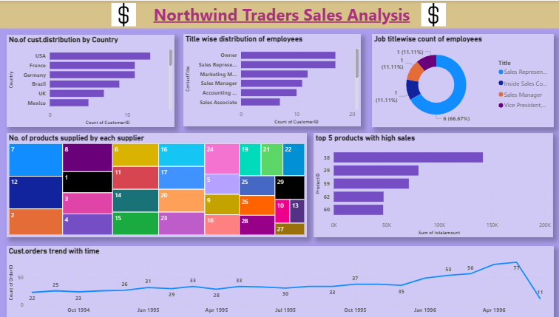
Sales analysis dashboard 1

Slide 9
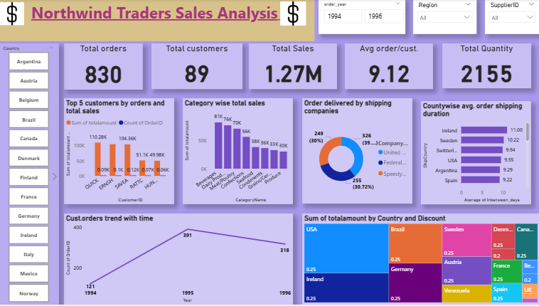
Sales analysis dashboard 2

Slide 10
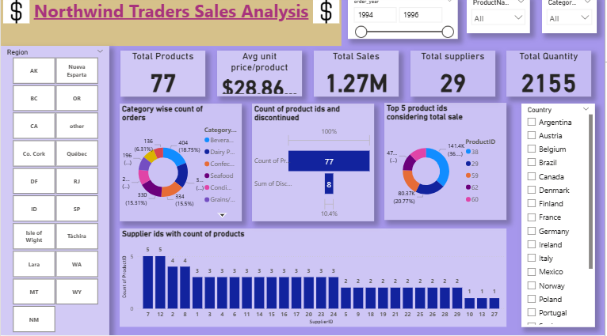
Sales analysis dashboard 3

Slide 11
Key Findings-
Sales Performance: Certain countries like USA and product categories like Beverages are consistently drive higher sales, indicating areas of strong market demand.
Customer Behavior: A small group of loyal customers with customer id-QUICK,SAVEA,FRNSH contributes significantly to overall revenue.
Employee performance –Employees with ids-1,3,4,8 have contributed well to higher order count. Employee performance varies significantly across regions,
Yearly performance-Considering all 3 years 1994 has 121 order count,1995 has 391 order count,1996 has 318 order count
Uncovered Till now-
total orders-830
Total sale-1.2 ML
Avg order/cust-9
Avg shipping duration-8days
Avg price/product=$28.8
Total customers-89

Slide 12
suggestions to improve Overall sale-
giveaways -discounts ,offers should be given to customers in the region/country which has less sale
Campaigning –should be done to inform about various products and categories
Employee Productivity: Should provide training or incentive programs.
Inventory Trends: optimized stock management is needed according to requirements of products
Shipping duration-avg. shipping duration is 8 days ,which should minimized

Slide 13
Conclusion
The Northwind Traders Sales Analysis project successfully integrated and analyzed data from multiple sources — including customers, orders, products, order details, suppliers etc — to generate meaningful business insights. Through structured data cleaning and transformation in Excel and SQL, inconsistencies were resolved, and relationships across datasets were clearly established.
Exploratory Data Analysis (EDA) revealed key sales trends, customer purchase patterns, and product performance indicators. Power BI visualizations provided an interactive and dynamic dashboard that allows stakeholders to explore sales by region, category, and time period, monitor employee performance, and identify high-value customers and top-selling products.

